Slide 1

REAL TIME SHARE MARKET ANALYSIS USING MACHINE LEARNING
Presented By
BASAVARAJ SAVALAGI 1DS17IS402
DEEPAK KUMAR N 1DS17IS405 GIRISH BABU J N 1DS17IS407
MOHAMMED SUFIYAAN BIAG 1DS17IS413
Under The Guidance Of
Prof. VAIDEHI M
Assistant Professor
Dept. of Information Science and Engineering
DSCE, Bangalore

Slide 2

CONTENTS
Abstract
Introduction
Problem Statement
System Design
Objective of the Project
Implementation
Software and Hardware Requirements:
Project Outcomes
Results
Conclusion
References

Slide 3

ABSTRACT:
The price of the stocks is an important indicator for a company and many factors can affect their values.
Different events may affect public sentiments and emotions differently, which may have an effect on the trend of stock market prices. Because of dependency on various factors, the stock prices are not static, but are instead dynamic, highly noisy and nonlinear time series data.
Due to its great learning capability for solving the nonlinear time series prediction problems, machine learning has been applied to this research area.
Learning-based methods for stock price prediction are very popular and a lot of enhanced strategies have been used to improve the performance of the learning based predictors.

Slide 4
Introduction
Financial market are highly inconstant and generate huge amount of data daily.
Stock is most popular financial market instrument and its value changes quickly
Stock prices are predicted to determine the future value of companies stock or other financial instruments that are marketed on financial exchange.
However the stock market is influenced by many factors such as political events, economic conditions and trader expectation.

Slide 5

PROBLEM STATEMENT:
Stock market prediction is basically defined as trying to determine the stock value and offer a robust idea for the people to know and predict the market and the stock prices.
Hence, we are contemplating towards the study of machine learning with various datasets integration to predict the market and the stock trends.
Stock market prediction, calls for an ability to predict the effect of recent events on the investors. These events can be political events like a statement by a political leader, a piece of news on scam etc.
All these factors make stock price prediction very difficult. Once the right data is collected, it then can be used to train a machine and to generate a predictive result

Slide 6
System Architecture
RAW DATA
FEATURE
EXTRACTION
TRAINING DATA
TESTING DATA
TRAINED DATA RESULT
PREDICTED STOCK PRICE

Slide 7
System Architecture
In the proposed model, we divide the dataset into two parts i.e. the training set and the testing set.
The training set is used to train the data and learn about the share qualities while the testing set is used for prediction.
In the training set, we calculate the absolute value of change in a share price over the time interval for every day and take the mean of it.

Slide 8
System Design Data Flow Diagram
Input: Company
Fetch Data
Plot Data
Train Model
Save Model
Plot Predicted Results
Predict Stock For N Days

Slide 9
System Design
To design a stock prediction model first we need a raw data which is the historical data or prices from a company which is called Data Sets it is the initial step.
Training the machine is similar to feeding the data to the algorithm to touch up the test data.
Testing the data which is extracted from the data
pre-processing technique and validates the data
to the training the machine.

Slide 10

OBJECTIVE:
The objective of this project is to predict future values of financial stock of company.
The recent trend in stock market prediction technologies is the use of machine learning which makes predictions based on the values of current stock market indices by training on their previous values.
The stock market is a transformative, non-straight dynamic and complex system.
This project presents machine learning aided algorithms to evaluate the stock prices in the future to analyze market behavior .

Slide 11
Implementation
Modules
Module1: Data Sets Collection:
It collects the raw data
Module2: Dividing the raw data as two parts:
Training data
Testing data
Module3: Feature Extraction Module
Module4: Training Module
Module5: Prediction Module

Slide 12
SOFTWARE AND HARDWARE REQUIREMENTS:
HARDWARE: Processor – Intel® Core™ i3-6006U cpu@2.4Ghz or above
RAM - 4.00GB
system type- 64 bit Operating system, x64-based processor
SOFTWARE: sublime Text3, Jupyter Notebook

Slide 13
Modern Tools:
Web programming tools are used to develop web application.
Sublime Text3 is used as Source code Editor.
Datasets are collected from various open accessible web sites which allows us to collect the data such as:
Yahoo finance
Quandl
Nasdaq
TATA global beverages
BSE etc

Slide 14
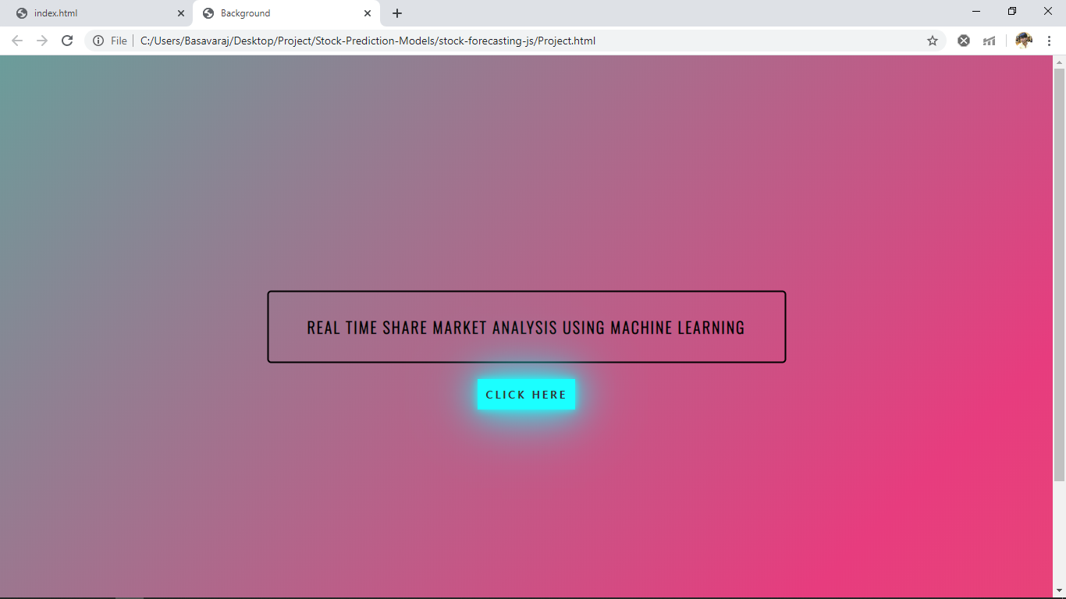
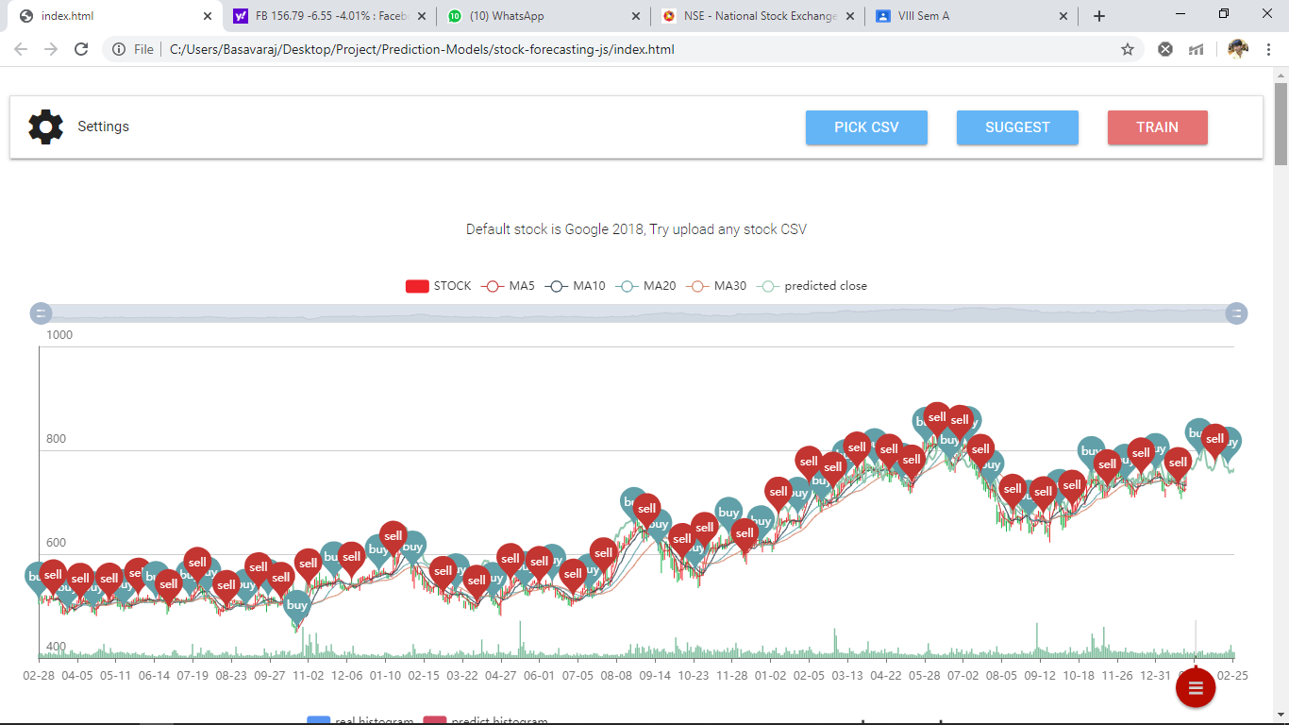
Project Outcomes

Slide 15
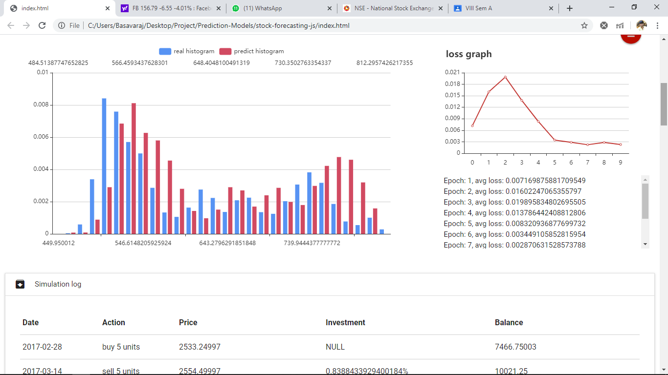
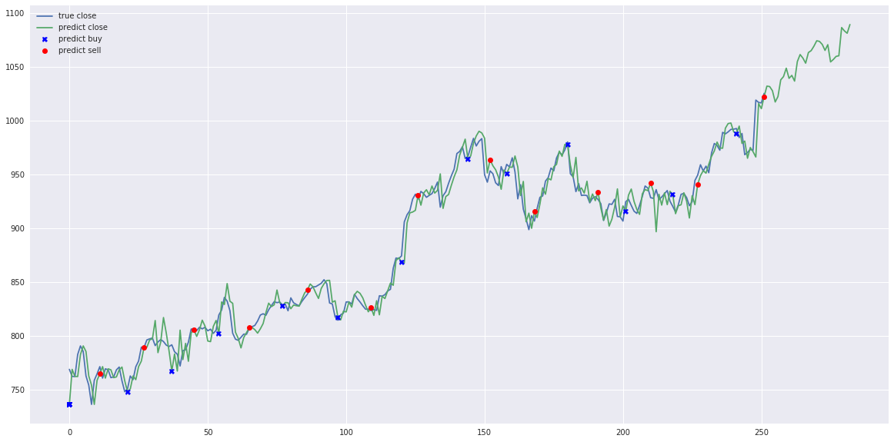

Slide 16
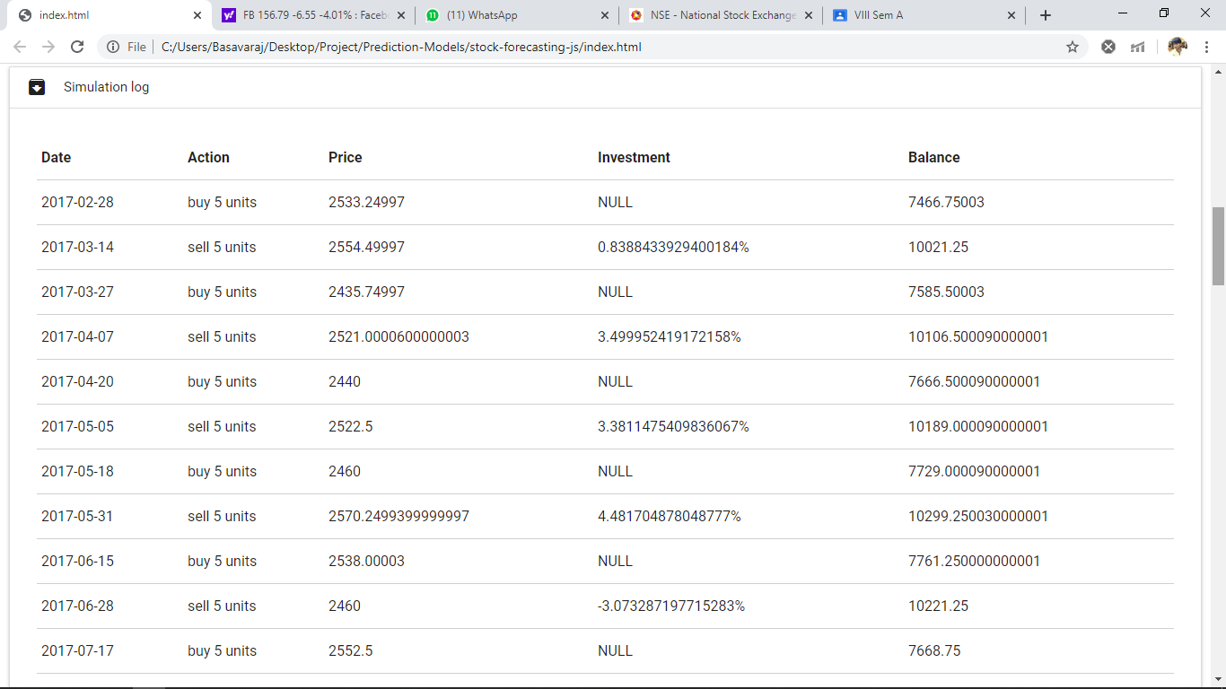
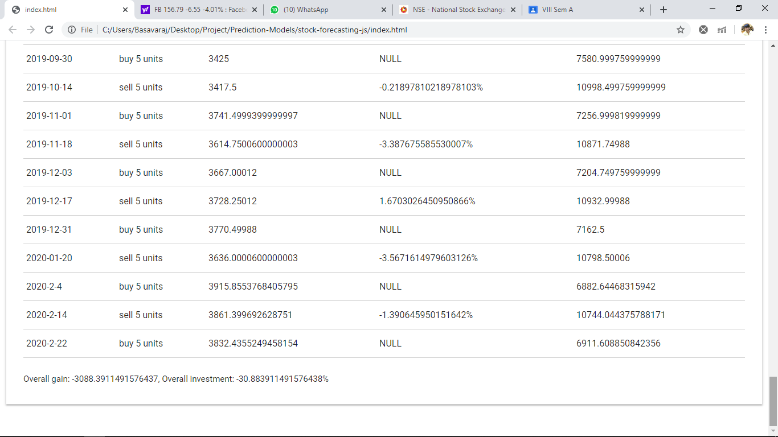

Slide 17
Result
This is the actual model that is used for the Stock Prediction. List of the datasets that is used to get future stock trends.Processing for a future stock prices is done and Plots the graph using histogram, echart, buy-sell graph.
This prediction is done using LSTM algorithm, this avoid the long-term dependency problem. Remembering information for long periods of time is practically their default behavior. However in the case of LSTM, it uses information from previous lags to predict the future instances. Since stock market is a highly dynamical system,the patterns and dynamics existing with in the system will not always be the same.
Testing the data which is extracted from the data pre-processing technique and validates the data to the training the machine.Training the machine is similar to feeding the data to the algorithm to touch up the test data. Predicting the stock prices of a company of desired days using the machine learning models. Plotting the predicted stock price result of a company in the graphs and histograms, as output for the users.

Slide 18
Conclusion
Thus, as we can see above in our proposed method, we train the data using existing stock dataset that is available. We use this data to predict and forecast the stock price of n-days into the future.
The average performance of the model decreases with increase in number of days, due to unpredictable changes in trend.
The current system can update its training set as each day passes so as to detect newer trends that predicts stock in real-time.

Slide 19
References
[1] Mehak Usmani, Syed Hasan Adil , Kamran Raza and Syed Saad Azhar Ali.“ Stock Market Prediction Using Machine Learning Techniques”. In 2016.
[2] Saxena P, Pant, B, Goudar, R.H , Srivastav, S, Garg, V., Pareek, S.” Future predictions in Indian stock market through linguistic-temporal approach.” In: 7th International Conference on Intelligent Systems and Control (ISCO) 2018
[3] Paul. “Sentiment analysis in predicting the stock market trends” 2016.
[4] Bohn, Tanner A. 2017 "Improving Long Term Stock Market Prediction with Text Analysis." (2017).
[5] Md. Rafiul Hassan and Baikunth Nath. The University of Melbourne, Carlton 3010, Australia. “Stock Market Forecasting Using Hidden Markov Model” In 2005.
[6] Oliveira, Nuno, Paulo Cortez, and Nelson Areal. "The impact of microblogging data for stock market prediction” In 2017.
[7] Li, Xiaodong "Empirical analysis: stock market prediction via extreme learning machine."Neural Computing and Applications In 2016.
[8] Sorto, Max, Cheryl Aasheim, and Hayden Wimmer. "Feeling The Stock Market: A Study in the Prediction of Financial Markets Based on News Sentiment." In 2017.
[9] Radu Jacomin “Stock Market Prediction”,9th International Conference on System Theory, Control and Computing In 2015.
[10] Farahmandian M, Hatamlou A“ Solving optimization problems using black hole algorithm” In 2015.
[11] B. Liu, E. Blasch, Y. Chen, D.Shen, G. Chen, “Scalable Sentiment Classification for Big Data Analysis Using Naïve Bayes Classifier,” IEEE Intl Conf. on Big Data, In Oct 2013.
[12] C.W. Tsai, C. H. Hsieh, and M.C. Chiang, "Parallel Black Hole Clustering Based on Map Reduce",IEEE International Conference on Systems, Man, and Cybernetics (SMC), In 2015.

Slide 20
Thank You...

